Slide 1
Topic 11
Multi-Way Selection

Slide 2
Multi-Way Selection
Multi-way selection chooses among several alternatives.
Example decision table:
Score | Grade
90 and above | A
80 to 89 | B
70 to 79 | C
60 to 69 | D
59 and below | F

Slide 3
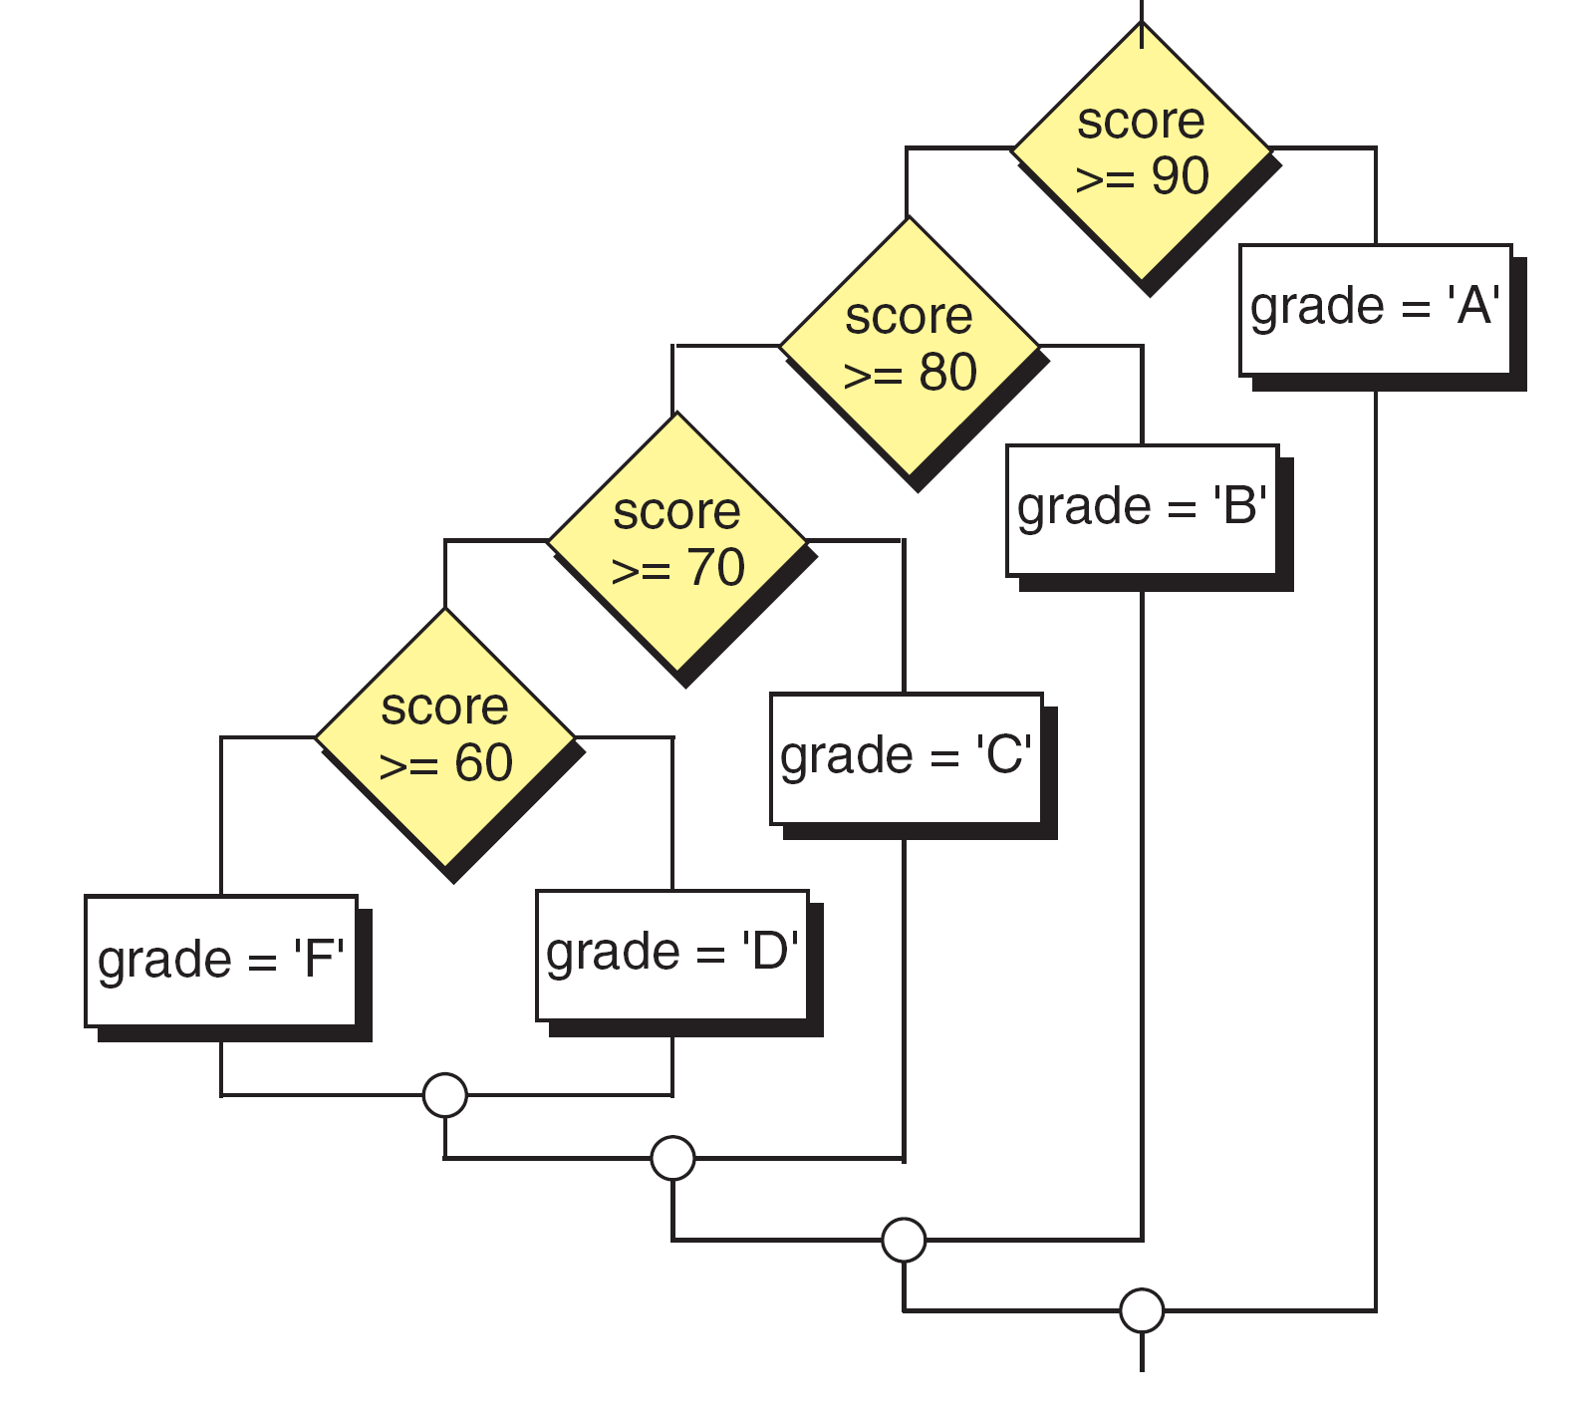
Multi-Way Selection
Multi-way selection chooses among several alternatives.
Example
in flowchart:
F
T
F
T
F
T
F
T

Slide 4
Multi-Way Selection
F
T
Score is 90 and above.
F
T
Score is 80 to 89.
F
T
F
T
Score is 70 to 79.
Score is 60 to 69.
Score is 59 and below.

Slide 5
Multi-Way Selection
Need to test
score >= 80 && score < 90?
F
T
F
T
F
T
F
T

Slide 6
Nested if Statements
Multi-way selection can be implement in C/C++ using nested if statements.
Nested if statements are if statements written inside other if statements.

Slide 7
Nested if Statements
Example:
if (score >= 90)
grade = 'A';
else
if (score >= 80)
grade = 'B';
else
if (score >= 70)
grade = 'C';
else
if (score > = 60)
grade = 'D';
else
grade = 'F';
if statement nested in false (else) part.

Slide 8
Nested if Statements
Program style – alternative style:
if (score >= 90)
grade = 'A';
else if (score >= 80)
grade = 'B';
else if (score >= 70)
grade = 'C';
else if (score > = 60)
grade = 'D';
else
grade = 'F';

Slide 9
Nested if Statements
A nested if statement may also be used to test two variables.
Example:
if (weather == 'R')
if (wind_speed > 50)
cout << "Rainy and windy day\n";
else
cout << "Rainy day\n";
else
cout << "Sunny day\n";
if statement nested in true part.

Slide 10
Nested if Statements
A nested if statement may also be used to test two variables.
Example:
if (weather == 'R')
if (wind_speed > 50)
cout << "Rainy and windy day\n";
else
cout << "Rainy day\n";
else
cout << "Sunny day\n";
Weather is ‘R’ and wind speed is more than 50
Weather is ‘R’ but wind speed is not more than 50
Weather is not ‘R’

Slide 11
Nested if Statements
Can we combine the two conditions into one expression?
(weather == ‘R’ && wind_speed > 50)
A nested if statement may also be used to test two variables.
Example:
if (weather == 'R')
if (wind_speed > 50)
cout << "Rainy and windy day\n";
else
cout << "Rainy day\n";
else
cout << "Sunny day\n";

Slide 12
The switch Statement
Multi-way selection can also be implement in C/C++ using the switch statement.
A switch statement is a composite statement used to make a decision between many alternatives. The selection condition must be an integral type (data type int or char) but not data type double.

Slide 13
The switch Statement
The switch statement can be represented in a flowchart as follows:

Slide 14
The switch Statement
The general format for a switch statement:
One case to match each alternative value of the expression.
Default if no values match. Default is optional.

Slide 15
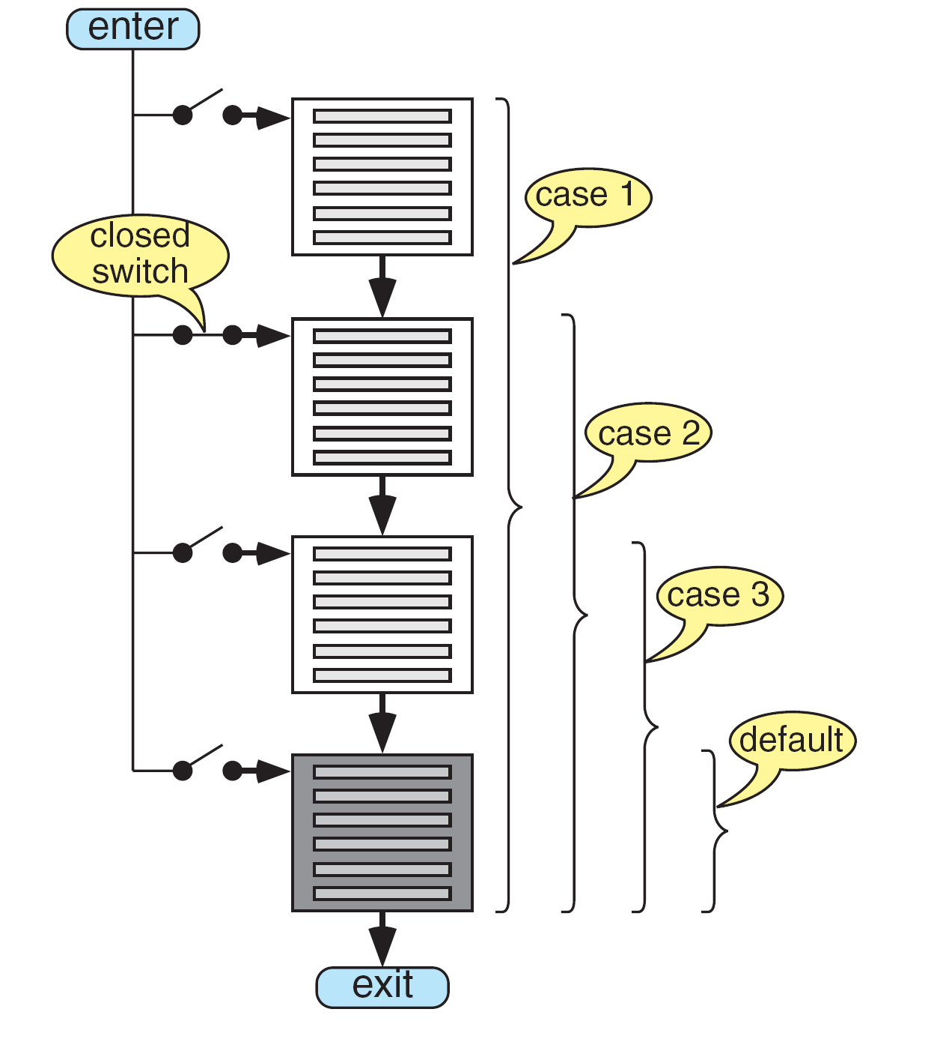
The switch Statement
How does the
switch statement
work?

Slide 16
The switch Statement
Example:
switch (printFlag)
{
case 1: cout << "This is case 1\n";
case 2: cout << "This is case 2\n";
default: cout << "This is default\n";
}
Possible outputs:

Slide 17
The switch Statement
If we want to execute only one of the case statements, we use break statements:
switch (printFlag)
{
case 1:
cout << "This is case 1\n";
break;
case 2:
cout << "This is case 2\n";
break;
default:
cout << "This is default\n";
break;
}

Slide 18
The switch Statement

Slide 19
The switch Statement
We can have the same action for several cases.
Example:
switch (ship_class)
{
case 'B':
case 'b':
cout << "Battleship\n";
break;
case 'C':
case 'c':
cout << "Cruiser\n";
break;
default:
cout << "Unknown ship class " << ship_class << endl;
break;
}

Slide 20
Nested if or switch Statement?
If the selection condition reduces to a set of individual values (e.g. 1, 2, 3, … or ‘A’, ‘B’, ‘C’, …), use either the nested if or the switch statement.
If the selection condition is based on a range of values (e.g. 0-24, 25- 49, 50-74), use the nested if statement.

Slide 21
Dangling else Problem
How does the C/C++ compiler interpret these nested if statements given in a general format?
if (expression1)
if (expression2)
statement 1;
else
statement 2;
Is the else connected to the first if or the second if?

Slide 22
Dangling else Problem
If the number of if and else do not match, the C/C++ compiler associates the else with the most recent unpaired if.
if (expression1)
if (expression2)
statement 1;
else
statement 2;

Slide 23
Dangling else Problem
If we want to change the association, we use braces. Example if we want the following association:
if (expression1)
{
if (expression2)
statement 1 1; }
else
statement 2;

Slide 24
Conditional Operator
C/C++ has a short-hand notation for the if-else statement.
It is called the conditional operator.
It has 2 symbols (? and :) and 3 operands.
General format:
expression1 ? expression2 : expression3
Example:
a == b ? x = a : x = 0;
which is the same as:
if (a == b)
x = a;
else
x = 0;

Slide 25
Case Study 1
Problem:
A program is required to calculate income tax for an employee based on the following decision table:
Income Bracket | Tax Schedule
Less than 10,000 | No tax
10,001 to 20,000 | 2% of income
20,001 to 30,000 | 400 + 3% of excess income above 20,000
30,001 to 50,000 | 700 + 5% of excess income above 30,000
50,000 and above | 1700 + 7% of excess income above 50,000

Slide 26
Case Study 1
Understand the problem:
For an employee earning 15,000:
tax = income x 2%
For an employee earning 60,500:
tax = 1700 + (60,500 - 50,000) x 7%

Slide 27
Case Study 1
Design the solution:
Algorithm
1. Get the income.
2. Compute the tax.
3. Display the tax.
Structure chart for program:
main
compute-tax

Slide 28
Case Study 1
Algorithm for function compute_tax:
If income is less than 10,000
tax is 0.0
else if income is between 10,001 and 20,000
tax is income x 2%
else if income is between 20,001 and 30,000
tax is 400 + (income - 20,000) x 3%
else if income is between 30,001 and 50,000
tax is 700 + (income - 30,000) x 5%
else
tax is 1700 + (income - 50,000) x 7%

Slide 29
Case Study 1 – Complete Program
#include <iostream>
using namespace std;
double compute_tax(double income);
int main(void)
{
double income; // input
double tax; // output
cout << "Enter income: ";
cin >> income;
tax = compute_tax(income);
cout << "Tax is " << tax << endl;
return 0;
}

Slide 30
Case Study 1 – Complete Program
double compute_tax(double income)
{
double tax; // local variable
if (income <= 10000)
tax = 0.0;
else if (income <= 20000)
tax = income * 0.02;
else if (income <= 30000)
tax = 400 + (income - 20000) * 0.03;
else if (income <= 50000)
tax = 700 + (income - 30000) * 0.05;
else
tax = 1700 + (income - 50000) * 0.07;
return tax;
}

